Slide 1
VISUAL QUESTION ANSWETRING (VQA)
Foundations of Machine Learning – Fall 2018
Daniel Rivera Ruiz
New York University

Slide 2
Outline
What is VQA?
The VQA Dataset
LSTM I+Q
Hierarchical Co-Attention
Stacked Attention Networks
Multimodal Residual Learning
Focused Dynamic Attention
Dynamic Memory Networks
Multimodal Compact Bilinear
DualNet Architecture
Results Comparison
The VQA 2.0 Dataset
Future work

Slide 3
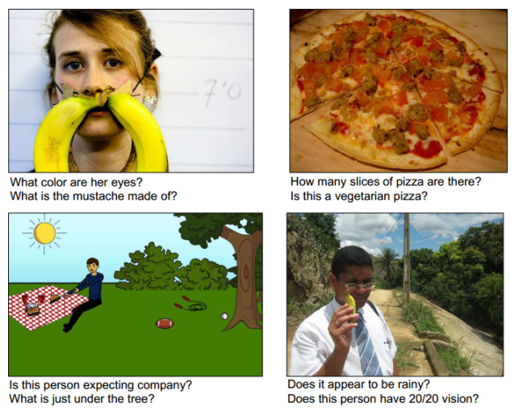
What is VQA?
Antol et al. (2015)
Image + Question = Answer
Intersection of Computer Vision and NLP
“AI-complete” task:
multimodal knowledge
Evaluation metric

Slide 4
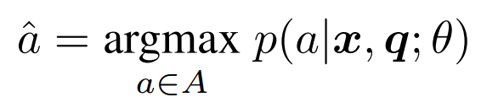
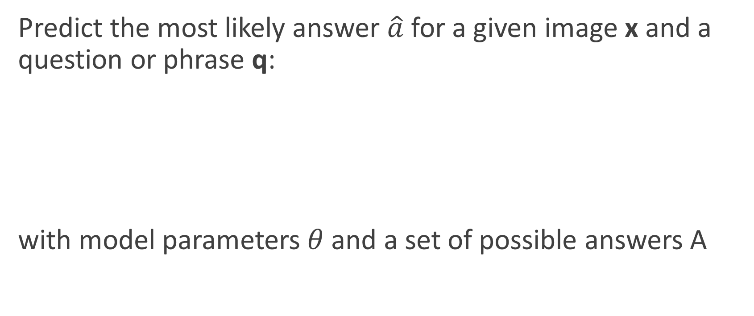
The problem
Antol et al. (2015)
Predict the most likely answer $\hat{a}$ for a given image x and a question or phrase q:
with model parameters $θ$ and a set of possible answers A

Slide 5
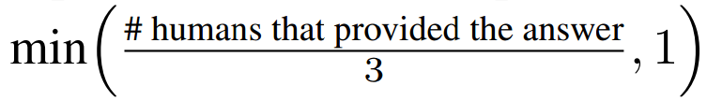
The dataset
Antol et al. (2015)
204,721 images from the MS COCO dataset
50,000 abstract scenes
3 questions per image (over 760,000)
10 answers per question
2 tasks: open-ended and multiple-choice
Open-ended accuracy metric:

Slide 6
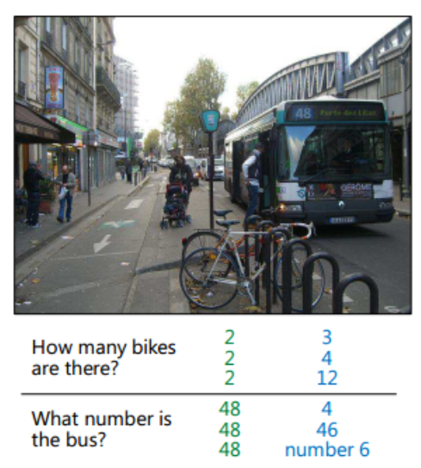
The dataset
Antol et al. (2015)
Plausible answers (blue) are collected for the multiple-choice task by having subjects answer the question without looking at the image

Slide 7
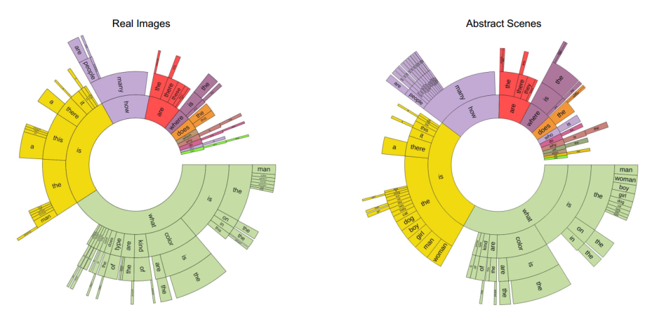
The dataset
Antol et al. (2015)

Slide 8
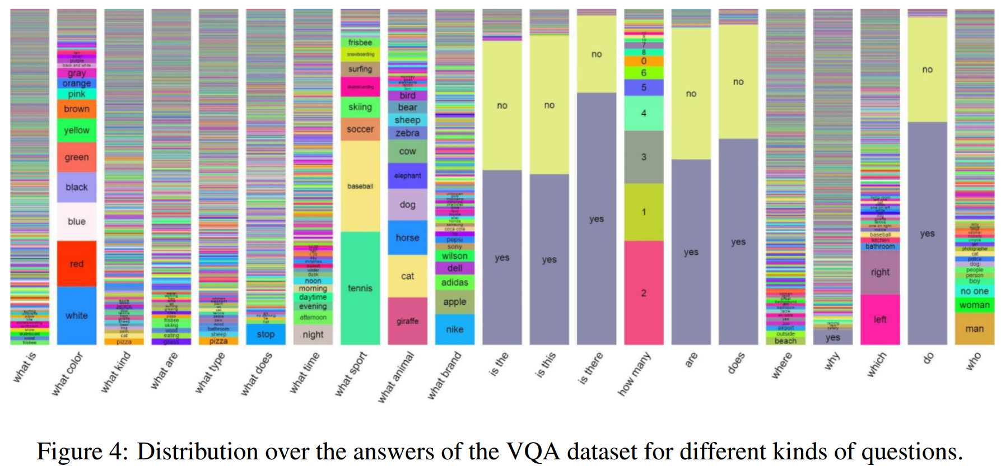
The dataset
Antol et al. (2015)

Slide 9
LSTM I+Q
Antol et al. (2015)
Baseline model published with the VQA dataset
Image features: last hidden layer (4096) of VGGNet
Question features: LSTM (1024)
Multimodality: element-wise multiplication (EWM)
Attention mechanism: none
Test-dev accuracy: 53.7%
Test-std accuracy: 54.1%

Slide 10
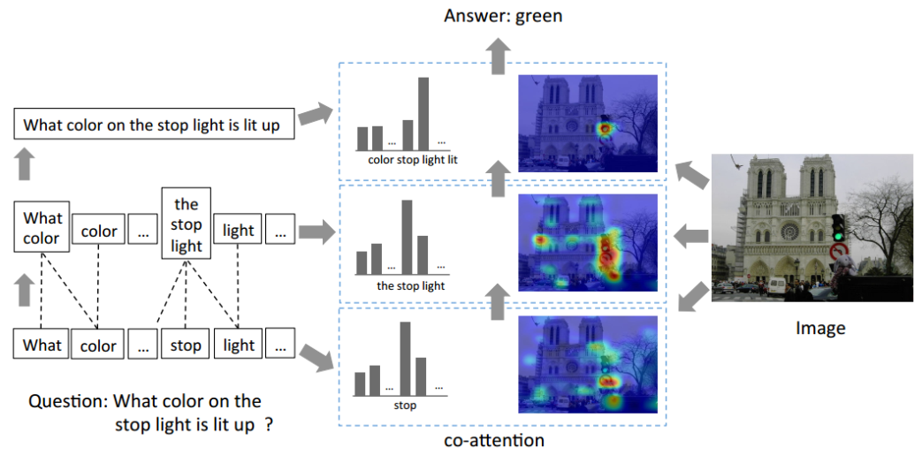
Hierarchical Co-Attention
Lu et al. (2016)

Slide 11
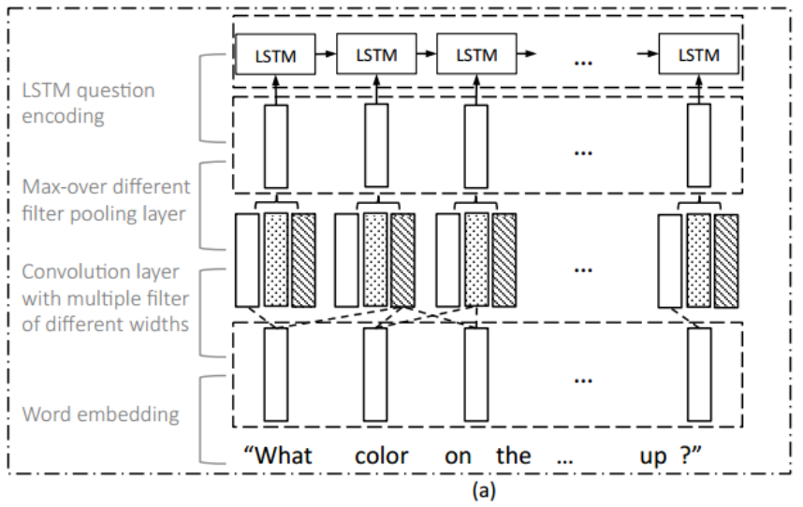
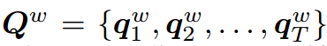
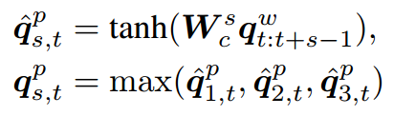
Hierarchical Co-Attention
Lu et al. (2016)
Question hierarchy

Slide 12
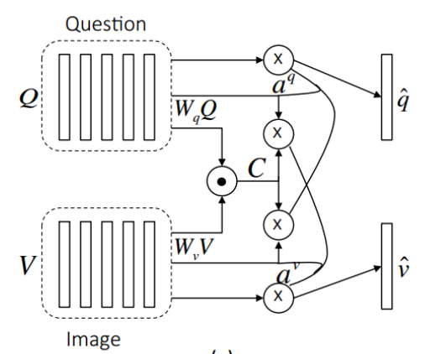
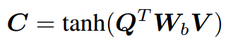
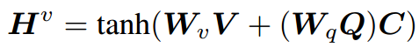
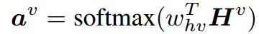
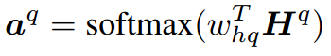
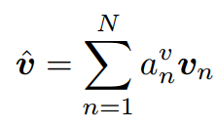
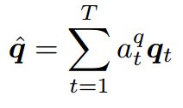
Hierarchical Co-Attention
Lu et al. (2016)
Parallel

Slide 13
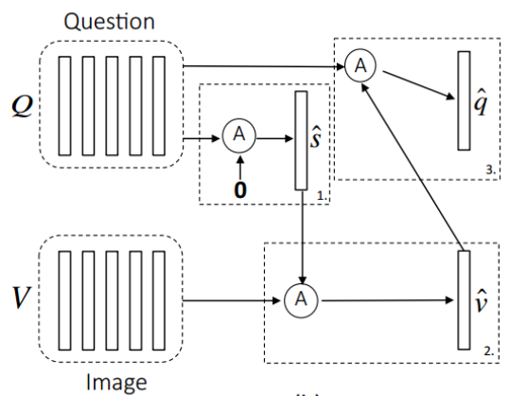
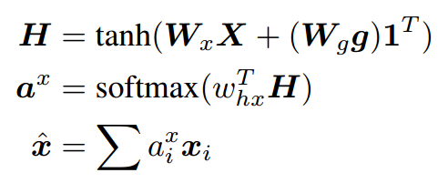
Hierarchical Co-Attention
Lu et al. (2016)
Alternating

Slide 14
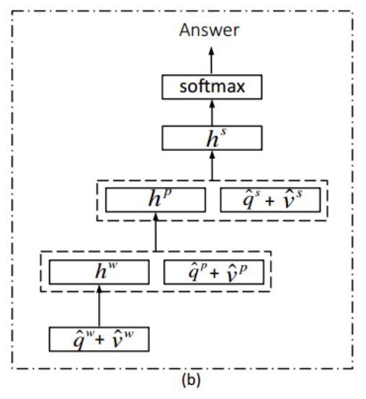
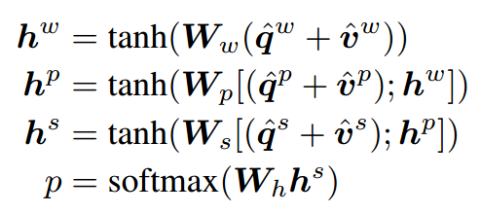
Hierarchical Co-Attention
Lu et al. (2016)
Prediction

Slide 15
Hierarchical Co-Attention
Lu et al. (2016)
Image features: last hidden layer (4096) of VGGNet
Question features: LSTM (1024)
Multimodality: EWM
Attention mechanism: Image + Question
Test-dev accuracy: 61.8%
Test-std accuracy: 62.1%

Slide 16
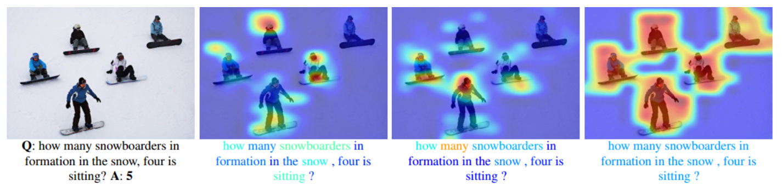
Hierarchical Co-Attention
Lu et al. (2016)

Slide 17
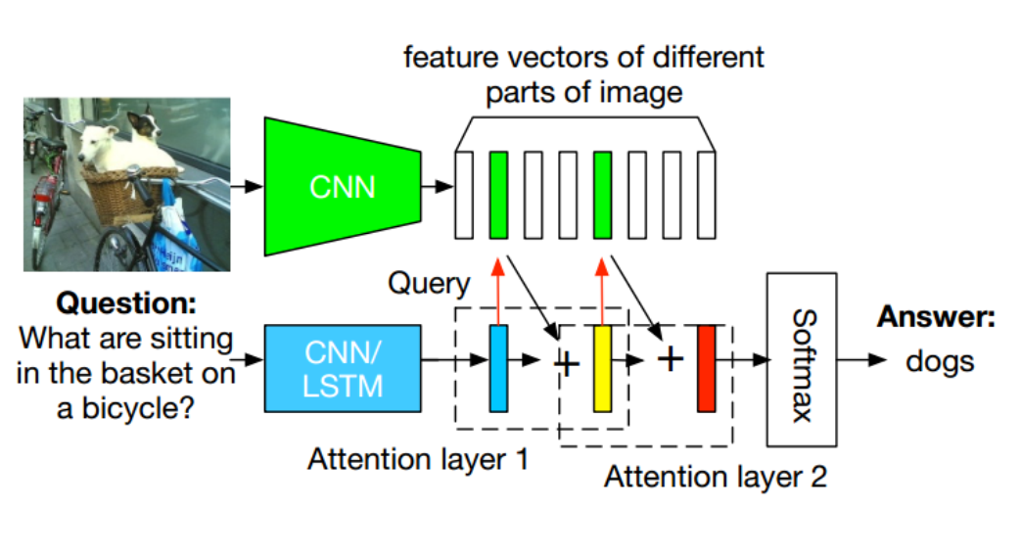
Stacked Attention Networks (SAN)
Yang et al. (2015)

Slide 18
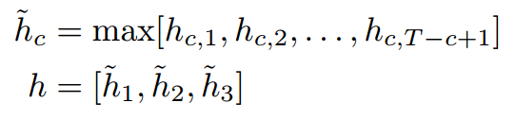
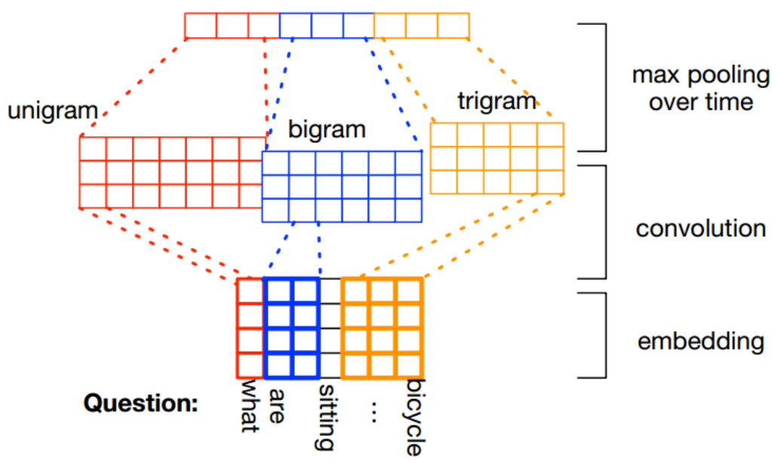
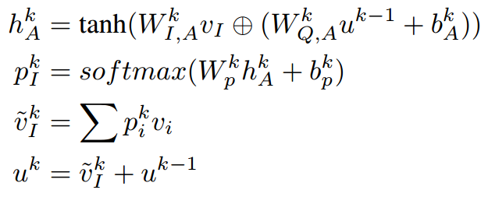
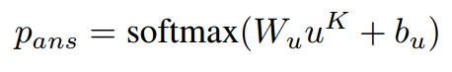
Stacked Attention Networks (SAN)
Yang et al. (2015)

Slide 19
Stacked Attention Networks (SAN)
Yang et al. (2015)
Image features: VGGNet (512)
Question features: CNN (1280)
Multimodality: EWM
Attention mechanism: Question
Test-dev accuracy: 58.7%
Test-std accuracy: 58.9%

Slide 20
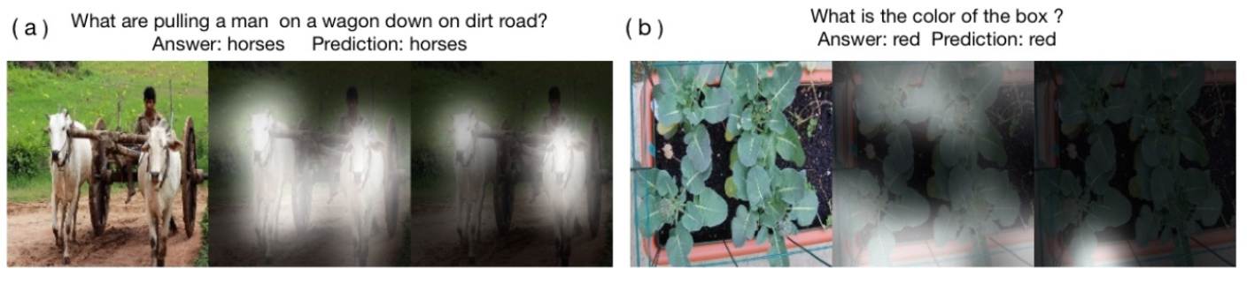
Stacked Attention Networks (SAN)
Yang et al. (2015)

Slide 21
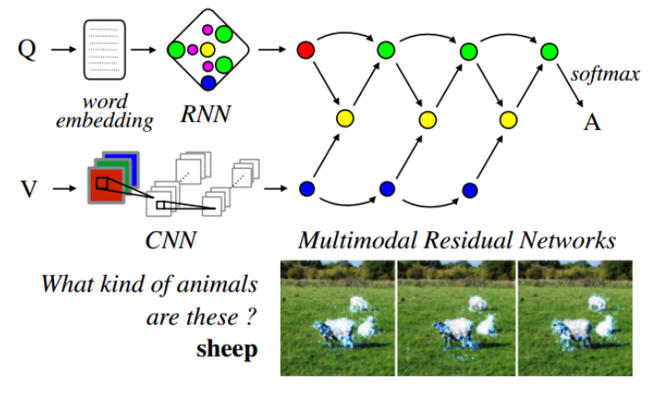
Multimodal Residual Network (MRN)
Kim et al. (2016)

Slide 22
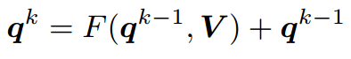
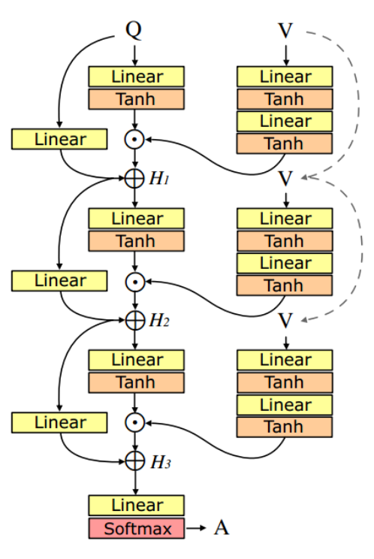
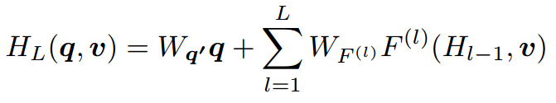
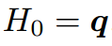
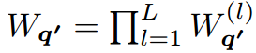
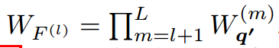
Multimodal Residual Network (MRN)
Kim et al. (2016)

Slide 23
Multimodal Residual Network (MRN)
Kim et al. (2016)
Image features: last hidden layer (4096) of VGGNet
Question features: GRU (2400)
Multimodality: EWM
Attention mechanism: Implicit
Test-dev accuracy: 60.5%
Test-std accuracy: 61.8%

Slide 24
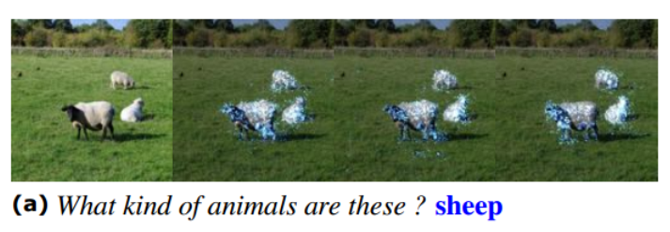
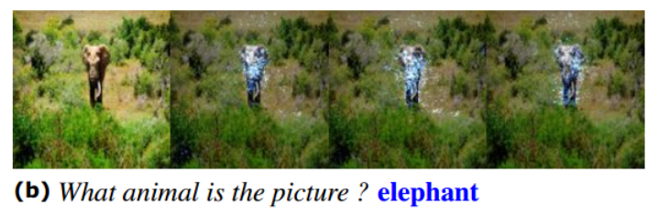
Multimodal Residual Network (MRN)
Kim et al. (2016)

Slide 25
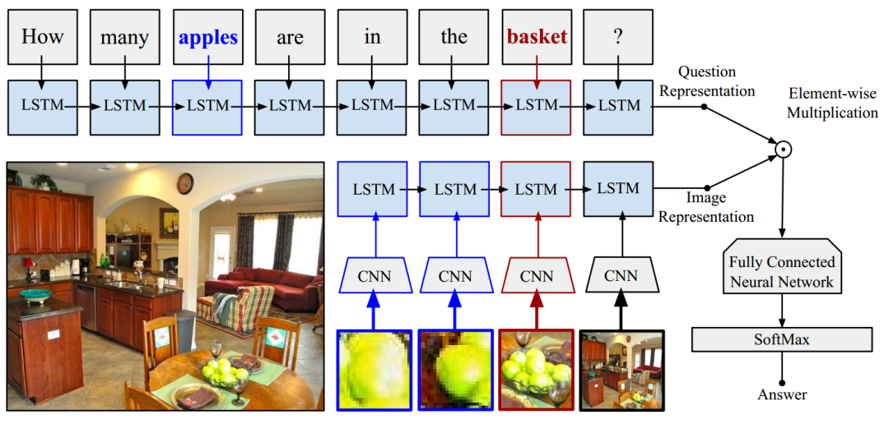
Focused Dynamic Attention (FDA)
Ilievski et al. (2016)

Slide 26
Focused Dynamic Attention (FDA)
Ilievski et al. (2016)
Image features: ResNet (2048)
Question features: LSTM (512)
Multimodality: EWM
Attention mechanism: Object detection
Test-dev accuracy: 59.2%
Test-std accuracy: 59.5%

Slide 27
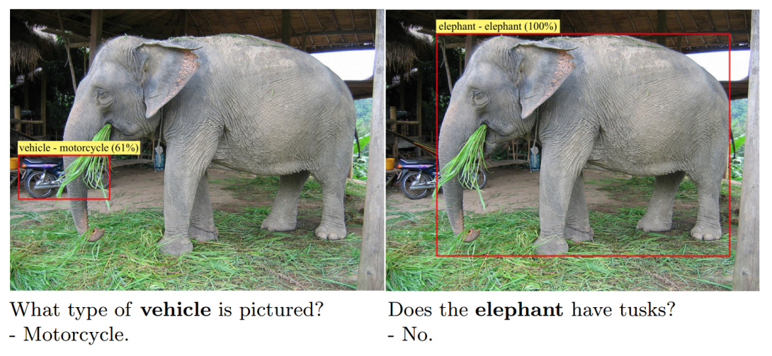
Focused Dynamic Attention (FDA)
Ilievski et al. (2016)

Slide 28
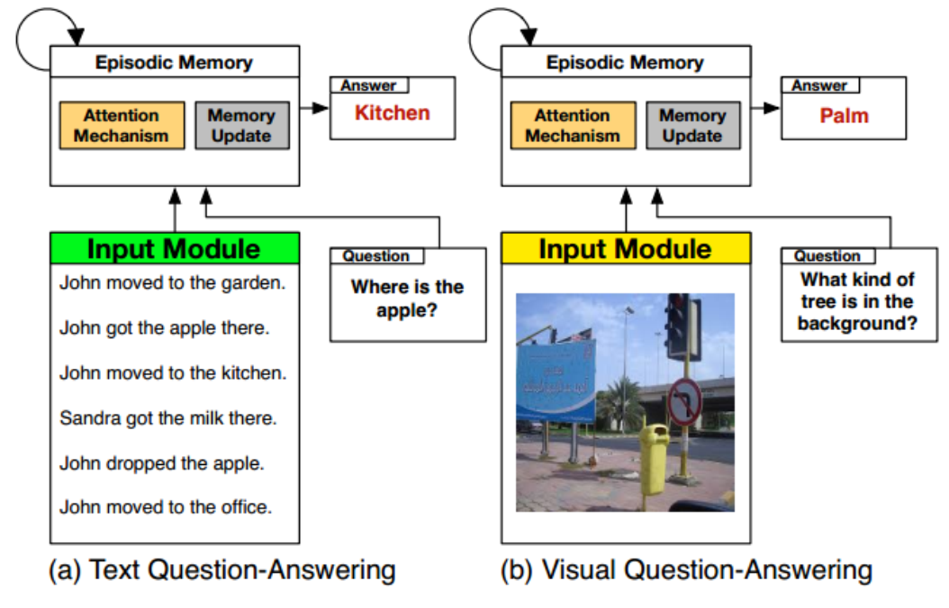
Dynamic Memory Networks (DMN)
Xiong et al. (2016)

Slide 29
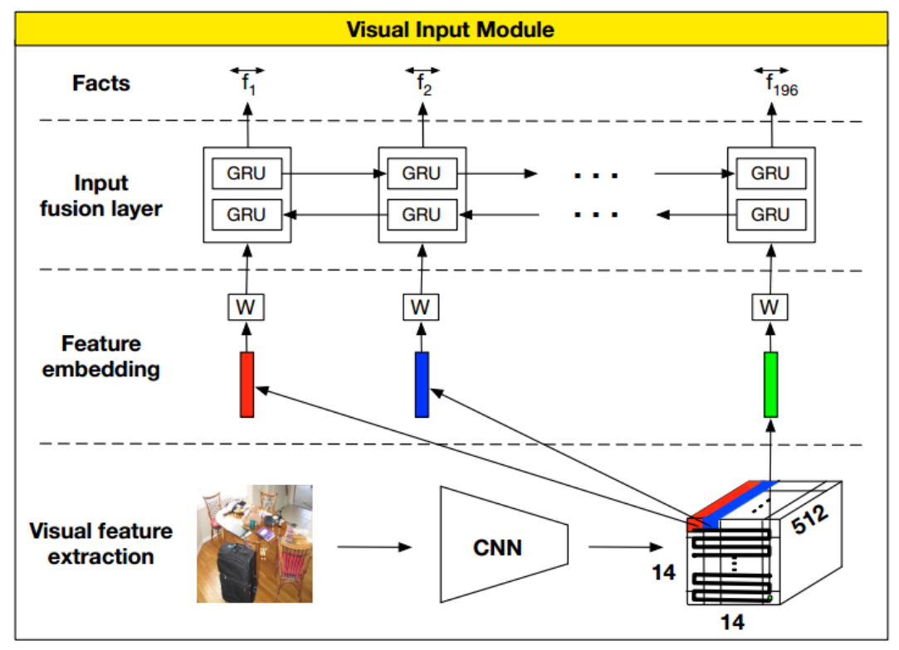
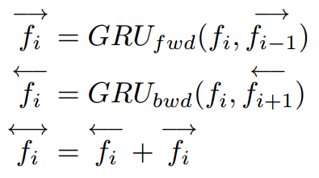
Dynamic Memory Networks (DMN)
Xiong et al. (2016)
Visual Input Module

Slide 30
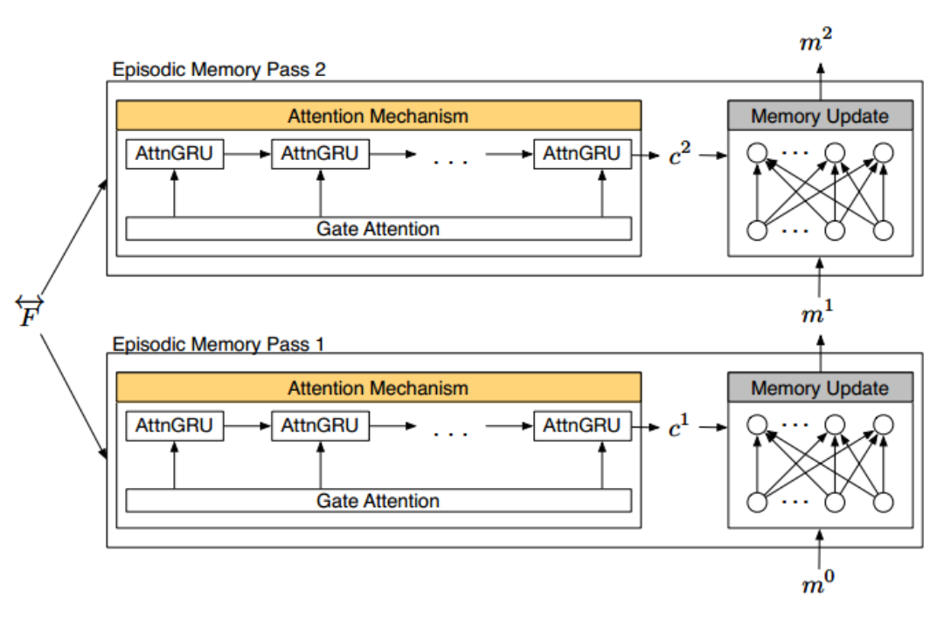
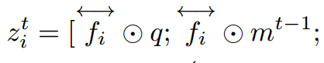
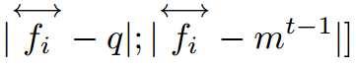
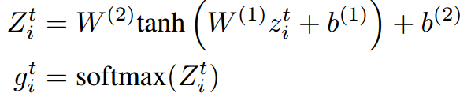
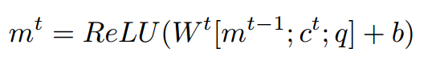
Dynamic Memory Networks (DMN)
Xiong et al. (2016)
Episodic Memory

Slide 31
Dynamic Memory Networks (DMN)
Xiong et al. (2016)
Image features: VGGNet (512)
Question features: GRU (512)
Multimodality: EWM + concatenation
Attention mechanism: Episodic memory
Test-dev accuracy: 60.3%
Test-std accuracy: 60.4%

Slide 32
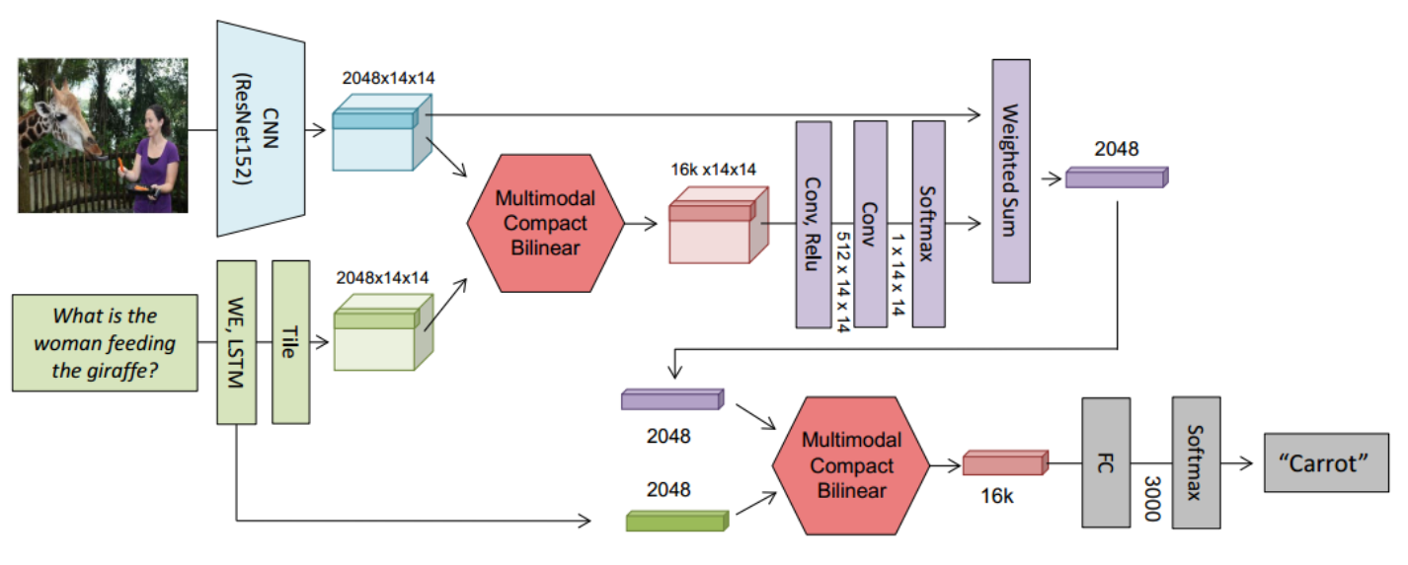
Multimodal Compact Bilinear (MCB)
Fukui et al. (2016)

Slide 33
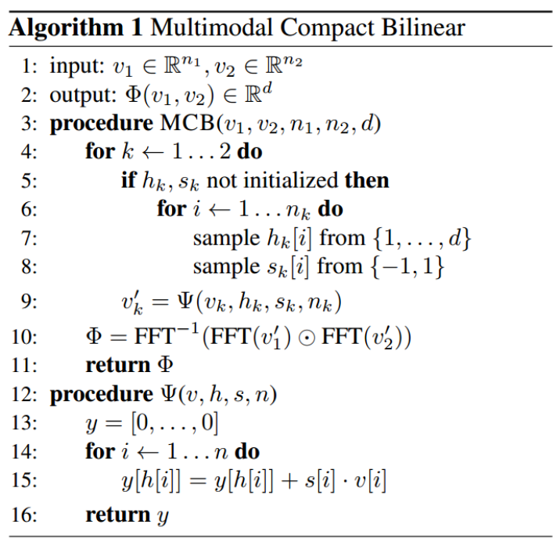

Multimodal Compact Bilinear (MCB)
Fukui et al. (2016)

Slide 34

Multimodal Compact Bilinear (MCB)
Fukui et al. (2016)

Slide 35
Multimodal Compact Bilinear (MCB)
Fukui et al. (2016)
Image features: ResNet (2048)
Question features: LSTM (1024)
Multimodality: MCB Pooling (Count Sketch + FFT)
Attention mechanism: MCB Pooling
Test-dev accuracy: 66.7%
Test-std accuracy: 66.5%

Slide 36

DualNet
Saito et al. (2016)

Slide 37



DualNet
Saito et al. (2016)

Slide 38
DualNet
Saito et al. (2016)
Image features: ResNet152 + ResNet101 + VGGNet19
Question features: LSTM (1024)
Multimodality: EWM + Summation
Attention mechanism: None
Test-dev accuracy: 61.5%
Test-std accuracy: 61.7%

Slide 39

Algorithms Comparison

Slide 40

Results Comparison

Slide 41

VQA 2.0
Goyal et al. (2016)

Slide 42

VQA 2.0
Goyal et al. (2016)

Slide 43

VQA 2.0
Goyal et al. (2016)

Slide 44
Future Work
Counting mechanisms
Apply MCB to other models
Kernel methods
Ensemble methods
Emphasize image understanding (VQA 2.0)

Slide 45

References

Slide 46

References

Slide 47
Thank You!

